Slide 1
發票主檔&發票明細檔API

Slide 2
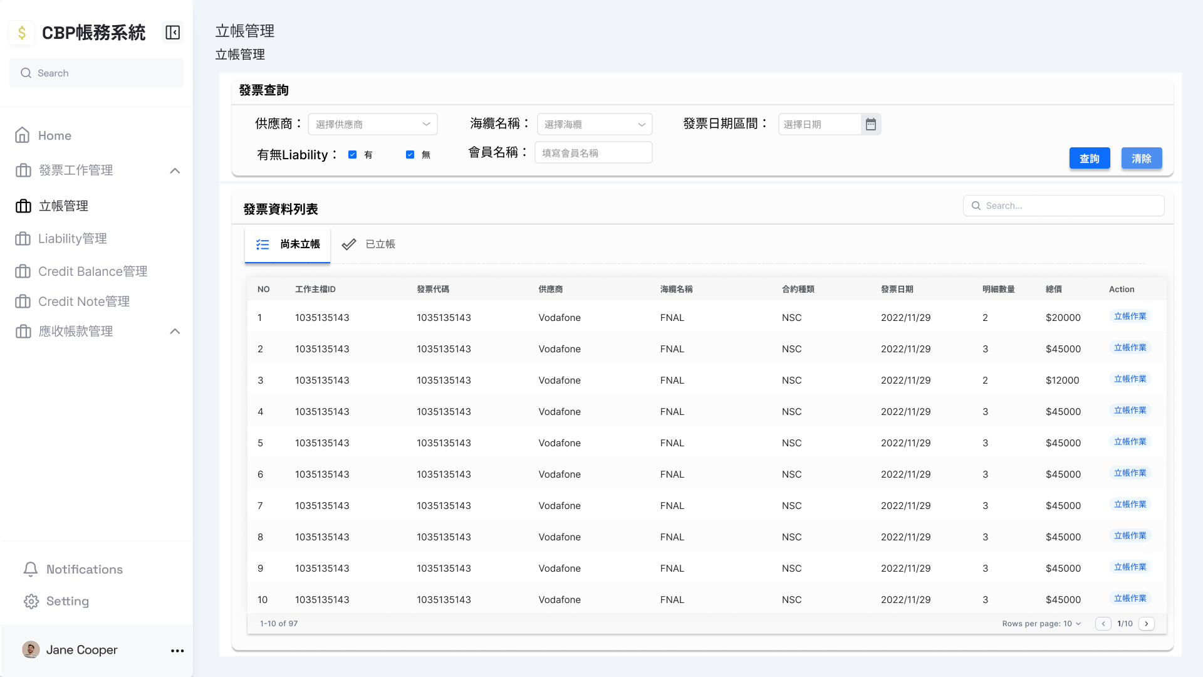
尚未立帳(1)
Response
{
"TotalAmount": 5582012.72,
"InvoiceMaster": [
{
"InvMasterID": 1,
"WKMasterID": 1,
"InvoiceNo": "DT0170168-1",
"PartyName": "Edge",
"SupplierName": "NEC",
"SubmarineCable": "SJC2",
"WorkTitle": "Construction",
"IssueDate": "2022-09-09T00:00:00",
"DueDate": "2022-11-08T00:00:00",
"IsPro": false,
"ContractType": "SC",
"Status": ""
},
{...},
{...}
],
"InvoiceDetail": [
{
"WKMasterID": 1,
"WKDetailID": 1,
"InvMasterID": 1,
"InvoiceNo": "DT0170168-1",
"PartyName": "Edge",
"SupplierName": "NEC",
"SubmarineCable": "SJC2",
"WorkTitle": "Construction",
"BillMilestone": "BM9a",
"FeeItem": "BM9a Sea...",
"LBRatio": 28.5714285714,
"FeeAmountPre": 1288822.32,
"FeeAmountPost": 368234.95,
"Difference": 0
},
{...},
{...}
]
}
Method: GET URL: http://127.0.0.1:8000/api/v1/getInvoiceMaster&InvoiceDetailStream/WKMasterID={WKMasterID} WKMasterID: 發票工作主檔ID

Slide 3
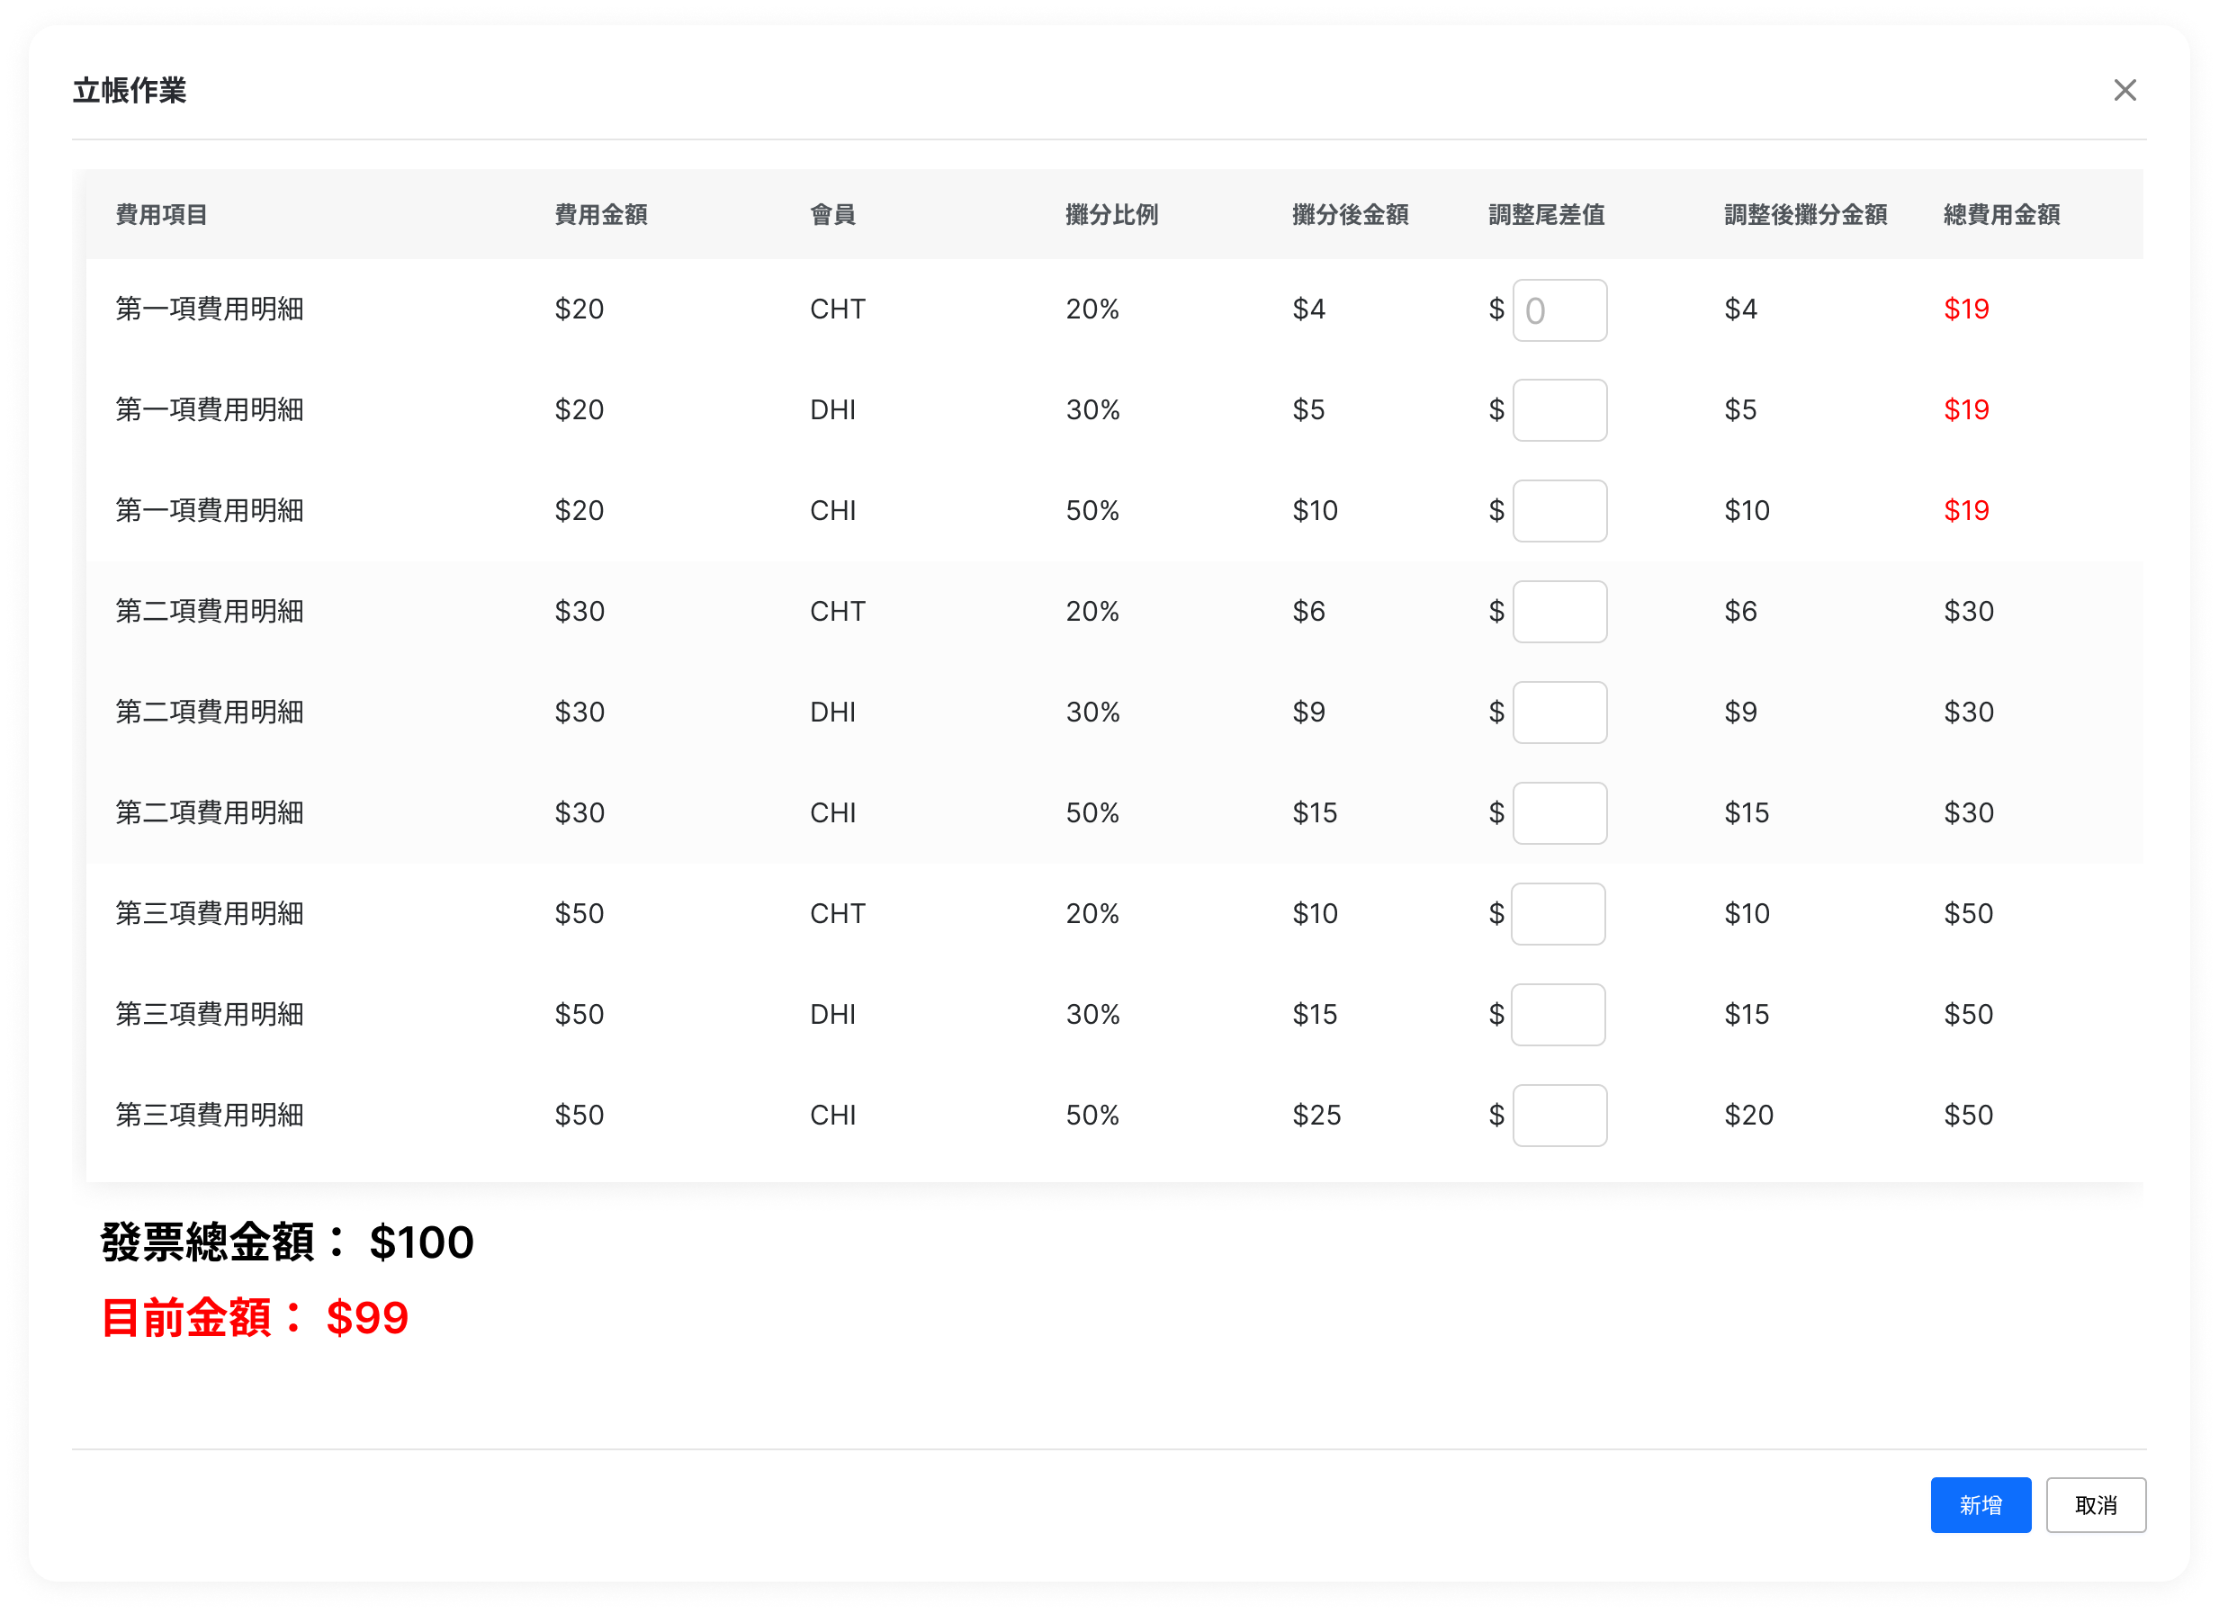
尚未立帳(2)
Response
{
"TotalAmount": 5582012.72,
"InvoiceMaster": [
{
"InvMasterID": 1,
"WKMasterID": 1,
"InvoiceNo": "DT0170168-1",
"PartyName": "Edge",
"SupplierName": "NEC",
"SubmarineCable": "SJC2",
"WorkTitle": "Construction",
"IssueDate": "2022-09-09T00:00:00",
"DueDate": "2022-11-08T00:00:00",
"IsPro": false,
"ContractType": "SC",
"Status": ""
},
{...},
{...}
],
"InvoiceDetail": [
{
"WKMasterID": 1,
"WKDetailID": 1,
"InvMasterID": 1,
"InvoiceNo": "DT0170168-1",
"PartyName": "Edge",
"SupplierName": "NEC",
"SubmarineCable": "SJC2",
"WorkTitle": "Construction",
"BillMilestone": "BM9a",
"FeeItem": "BM9a Sea...",
"LBRatio": 28.5714285714,
"FeeAmountPre": 1288822.32,
"FeeAmountPost": 368234.95,
"Difference": 0
},
{...},
{...}
]
}
Method: GET URL: http://127.0.0.1:8000/api/v1/getInvoiceMaster&InvoiceDetailStream/WKMasterID={WKMasterID} WKMasterID: 發票工作主檔ID

Slide 4
送出立帳
POST Body
{
"TotalAmount": 5582012.72,
"InvoiceMaster": [
{
"WKMasterID": 1,
"InvoiceNo": "DT0170168-1",
"PartyName": "Edge",
"SupplierName": "NEC",
"SubmarineCable": "SJC2",
"WorkTitle": "Construction",
"IssueDate": "2022-09-09T00:00:00",
"DueDate": "2022-11-08T00:00:00",
"IsPro": false,
"ContractType": "SC",
"Status": ""
},
{...},
{...}
],
"InvoiceDetail": [
{
"WKMasterID": 1,
"WKDetailID": 1,
"InvMasterID": 1,
"InvoiceNo": "DT0170168-1",
"PartyName": "Edge",
"SupplierName": "NEC",
"SubmarineCable": "SJC2",
"WorkTitle": "Construction",
"BillMilestone": "BM9a",
"FeeItem": "BM9a Sea...",
"LBRatio": 28.5714285714,
"FeeAmountPre": 1288822.32,
"FeeAmountPost": 368234.95,
"Difference": 0
},
{...},
{...}
]
}
Method: POST URL: http://127.0.0.1:8000/api/v1/addInvoiceMaster&InvoiceDetail
Content:

Slide 5
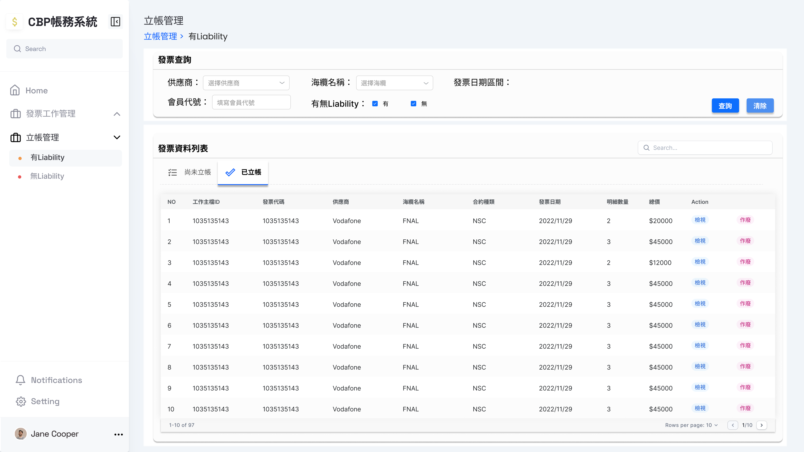
更新發票主檔狀態
POST Body
{
"WKMasterID": 1,
"Status": "INVALID"
}
Method: POST URL: http://127.0.0.1:8000/api/v1/updateInvoiceWKMaster
Content:
Method: POST URL: http://127.0.0.1:8000/api/v1/updateInvoiceMaster
Content:

Slide 6
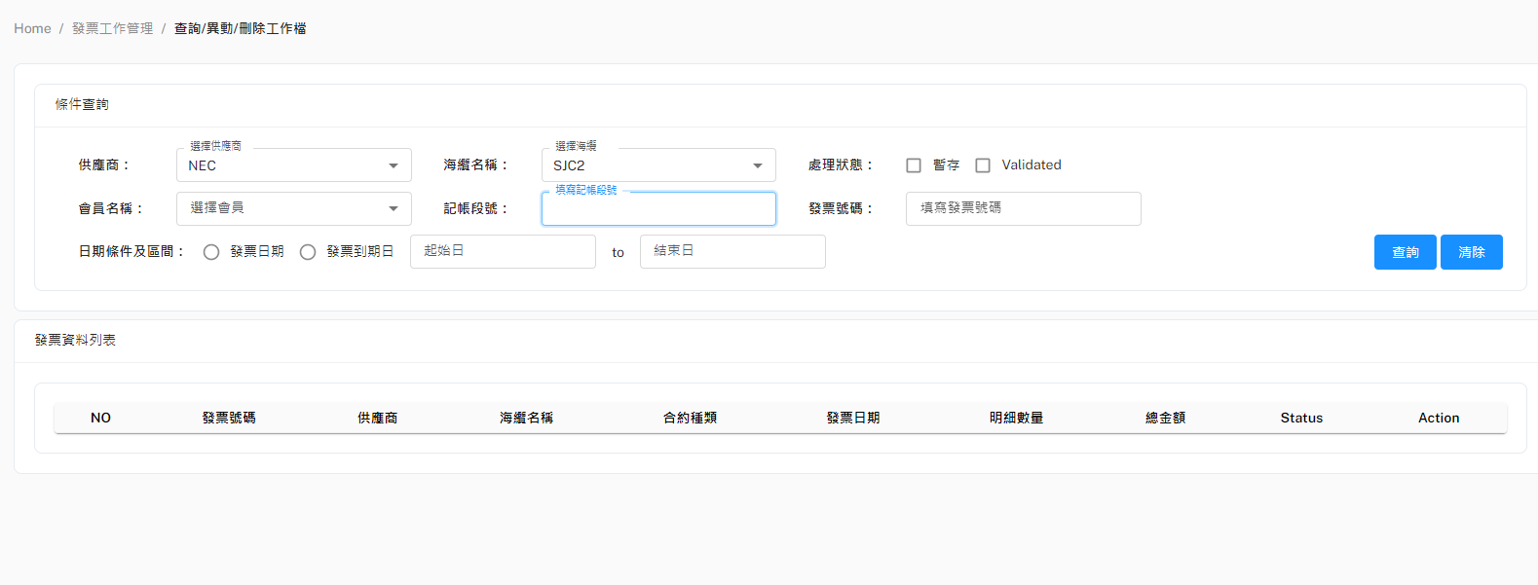
發票工作主檔查詢
Response
[
{
"InvoiceWKMaster": {
"WKMasterID": 1,
"InvoiceNo": "DT0170168-1",
"Description": "COMMERCIAL …",
"SupplierName": "NEC",
"SubmarineCable": "SJC2",
"WorkTitle": "Construction",
"ContractType": "SC",
"IssueDate": "2022-09-09T00:00:00",
"DueDate": "2022-11-08T00:00:00",
"PartyName": "",
"Status": "TEMPORARY",
"IsPro": false,
"IsRecharge": false,
"IsLiability": true,
"TotalAmount": 5582012.72,
"CreateDate": "2023-01-13T00:00:00"
},
"InvoiceWKDetail": [
{
"WKMasterID": 1,
"InvoiceNo": "DT0170168-1",
"SupplierName": "NEC",
"SubmarineCable": "SJC2",
"WorkTitle": "Construction",
"BillMilestone": "BM9a",
"FeeItem": "BM9a…",
"FeeAmount": 1288822.32
} ]
},
{…},
{…},
{…}
]
Method: GET
URL: http://127.0.0.1:8000/api/v1/Suppliers/all
Method: GET
URL: http://127.0.0.1:8000/api/v1/SubmarineCables/all
Method: GET
URL: http://127.0.0.1:8000/api/v1/dropdownmenuBillMilestone
ROOT_URL = http://127.0.0.1:8000/api/v1/getInvoiceWKMaster&InvoiceWKDetail
ROOT_URL/SupplierName=供應商&SubmarineCable=海纜名稱&PartyName=會員代號&Status=處理狀態&BillMilestone=計帳段號&startCreateDate=20230101&endCreateDate=20230131…
如果任條件都沒有: http://127.0.0.1:8000/api/v1/getInvoiceWKMaster&InvoiceWKDetail/all
如果起訖日都一樣，則給一樣的日期
(ex. startCreateDate=xxx&endCreateDate=xxx)

Slide 7
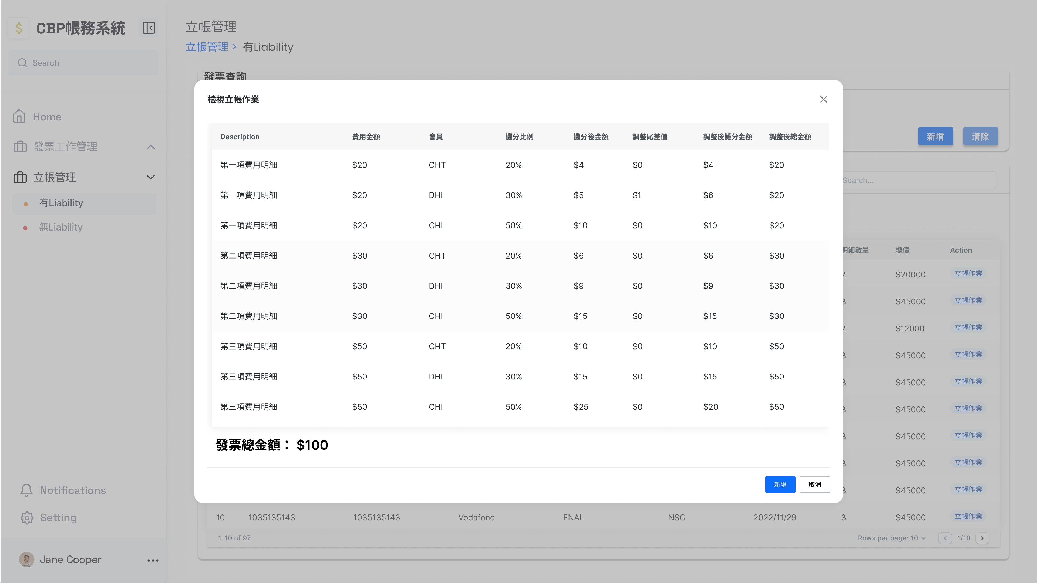
查詢發票主檔&發票明細檔
[
{
"SubmarineCable": "SJC2",
"WKMasterID": 1,
"ContractType": "SC",
"DueDate": "2022-11-08T00:00:00",
"Status": "TEMPORARY",
"IsRecharge": false,
"TotalAmount": 5582012.72,
"WorkTitle": "Construction",
"InvoiceNo": "DT0170168-1",
"SupplierName": "NEC",
"IssueDate": "2022-09-09T00:00:00",
"PartyName": "",
"IsPro": false,
"IsLiability": true,
"CreateDate": "2023-01-17T16:38:55"
}
]
[
{
"WKDetailID": 1,
"InvDetailID": 1,
"PartyName": "DHT",
"SubmarineCable": "SJC2",
"WorkTitle": "Construction",
"FeeItem": "BM9a Sea...",
"LBRatio": 3.5714285714,
"Difference": 0.0,
"InvMasterID": 1,
"WKMasterID": 1,
"InvoiceNo": "DT0170168-1",
"SupplierName": "NEC",
"BillMilestone": "BM9a",
"FeeAmountPre": 1288822.32,
"FeeAmountPost": 46029.37
},
{...},
{...}
]
Method: GET URL: http://127.0.0.1:8000/api/v1/InvoiceDetail/WKMasterID={WKMasterID}
Content:
Method: GET URL: http://127.0.0.1:8000/api/v1/InvoiceWKMaster/WKMasterID={WKMasterID}
Content:

